Slide 1
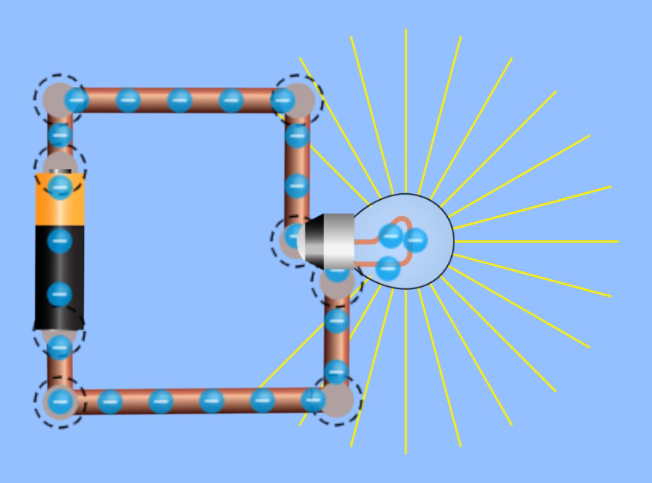
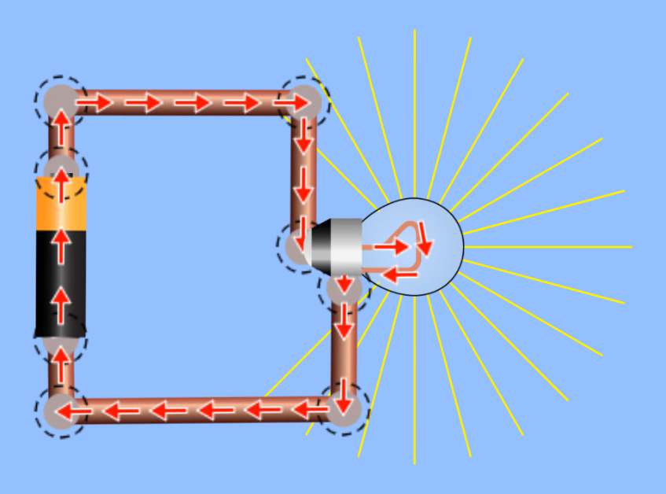
Electron Flow
Negative to positive
Conventional current
Positive to negative
Positive terminal
(high potential)
Electron flow
Conventional current
Negative terminal
(low potential)
Electrons “flow” from negative terminal of battery to positive
(negative charges repelled by negative charge build up in battery’s negative terminal)
Conventional current shows electric charges moving from positive to negative
(negative charges moving in one direction is equivalent to modeling an equal number of positive charges in the other direction)

